Slide 1


Welcome
Powered by TYYM
Powered by TYYM
Notes:
Loading page

Slide 2
Welcome
View Cases
Report Dengue Breeding Grounds
View Resources
Powered by TYYM
Notes:
Right: Menu page

Slide 3

Select your location
Select your location
Select location
Select location
Use current location
Ang Mo Kio
Bishan
Clementi
Dover
Eunos
Farrer Park
Powered by TYYM
Geylang

Slide 4
Report Dengue Breeding Ground
Your report has been successfully submitted!
Briefly tell us about the situation and location:
Type here
Upload image(s)
Submit Report
Powered by TYYM
Powered by TYYM

Slide 5

Dengue Resources
Do the 5-Step Mozzie Wipeout
Are you doing the Mozzie Wipeout correctly?
What are symptoms of Dengue?
Seek medical attention if you are showing these symptoms.
Powered by TYYM

Slide 6
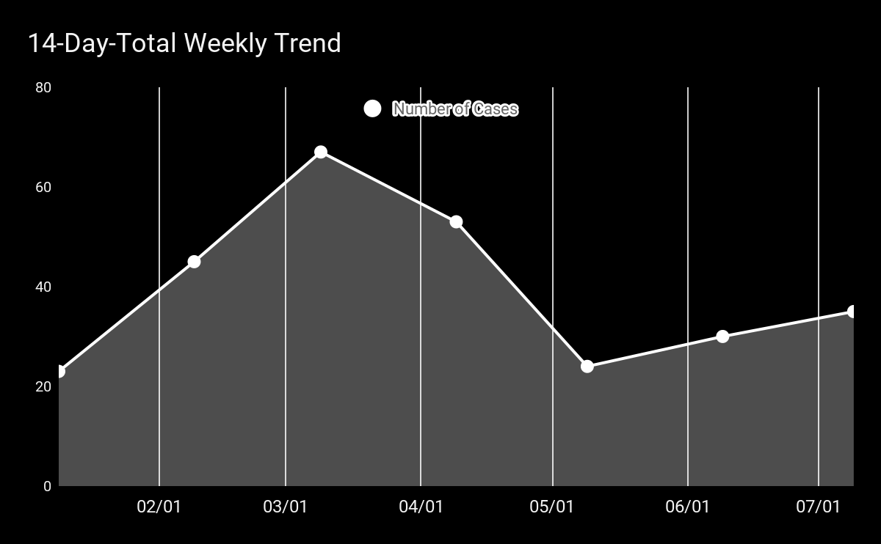
Your Location
Singapore
Your Location
Singapore
Your Location
Singapore
71 Marine Drive
71 Marine Drive
71 Marine Drive
15
7
0
Total cases in the past 14 days
Total cases in the past 14 days
Total cases in the past 14 days
Notes:
Display cases by location

Slide 7
Your Location
Singapore
Your Location
Singapore
Your Location
Singapore
Singapore Today
Singapore Today
Singapore Today
30
7
0
Total cases today
Total cases today
Total cases today
Notes:
Display total cases in Singapore today

Slide 8

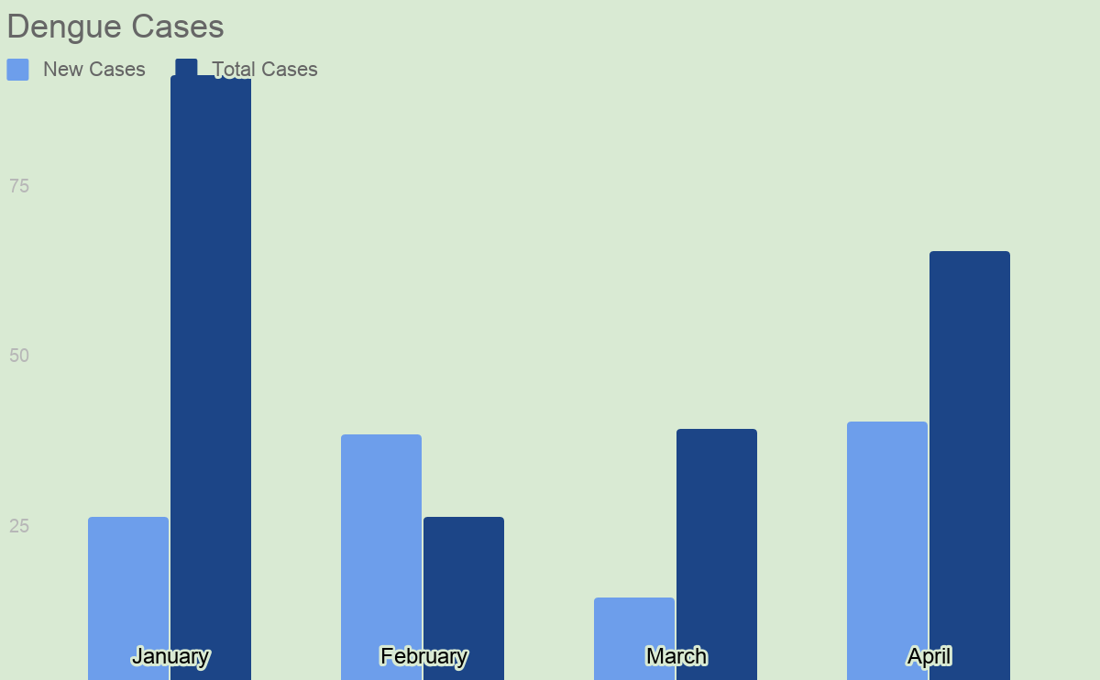
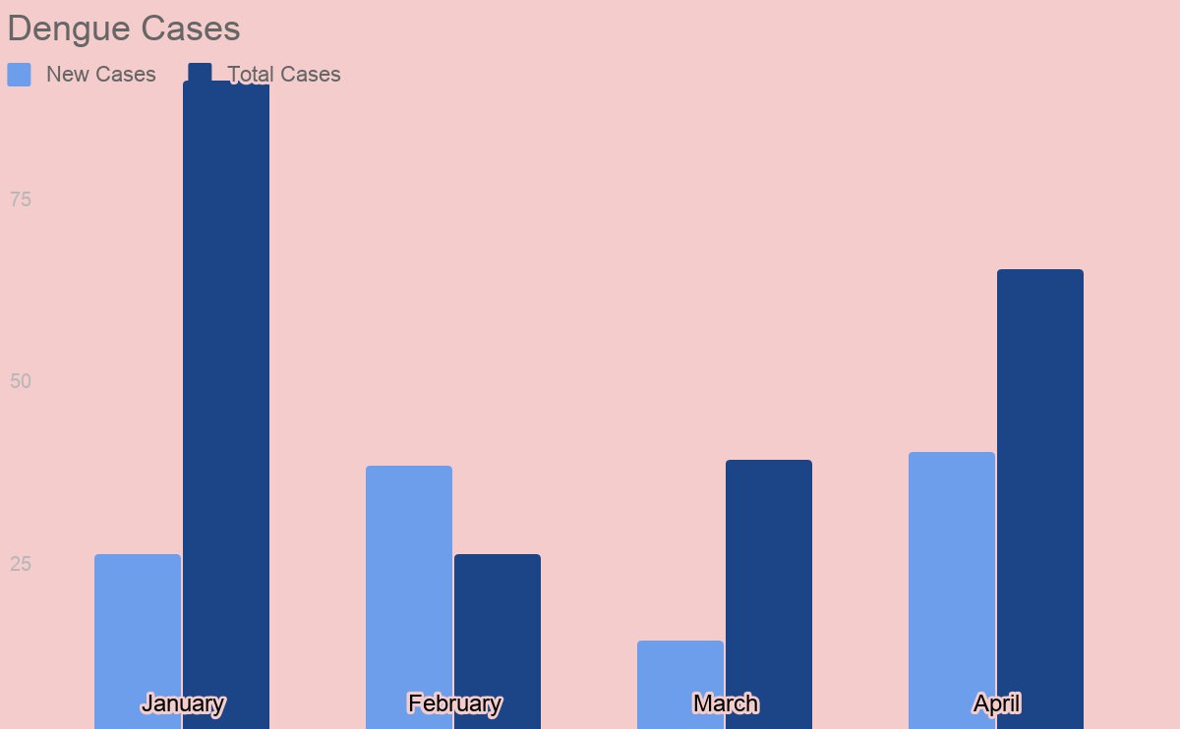

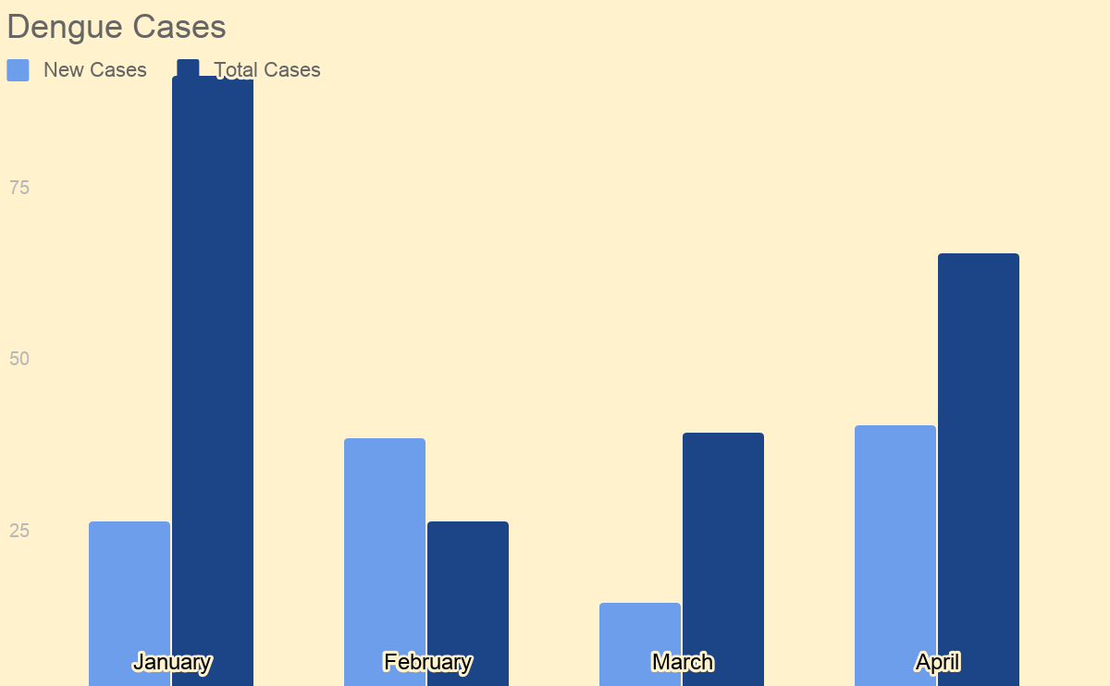
TYYM
TYYM
TYYM
your location
your location
your location
Singapore
Singapore
Singapore
11
5
1
new cases in Singapore today
new cases in Singapore today
new cases in Singapore today
Red alert level, take precautions!
Yellow alert level, do the mozzie wipeout!
Green alert level, keep it up!

Slide 9



TYYM
Scroll to move around
Pinch to zoom
Hotspots

Slide 10



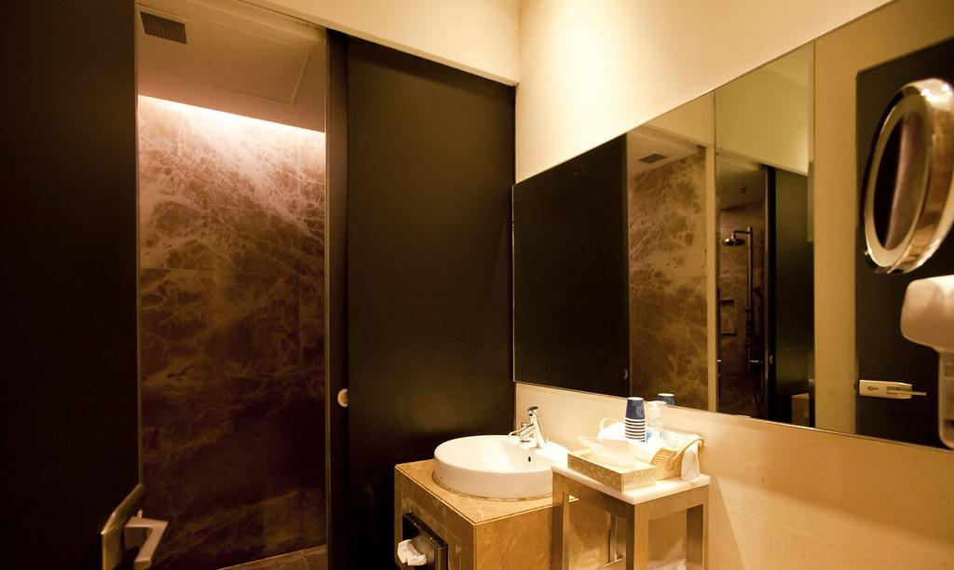
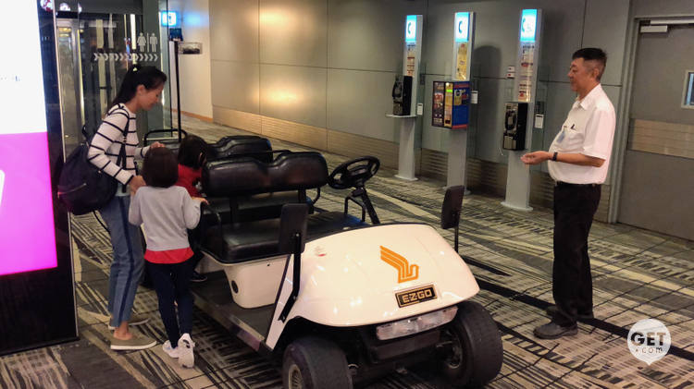

Welcome to SilverKris Lounge
Facilities Booking
Shower Facilities
Time to boarding
Time to boarding
Flight
SQ123
Flight
SQ123
Your flight SQ123 to SIN
Boarding gate: A01
Time to boarding: 2 hours 15 min
Flight Status: On time
2h
2h
Shower Facilities
Freshen up before your travels. Check availability and services available.
Facilities Booking
Book shower facilities, buggy rides to your gate, and many others.
Dining Menu
International cuisine prepared by top culinary experts, right here in the SilverKris lounge.
Available units
Buggy Services
Reduce your travelling time to your boarding gate. Enjoy direct buggy chauffeuring services.
5
Lounge Occupancy
Check lounge occupancy rates updated in real time across all 3 KrisFlyer lounges.
Timing:
Select a timeslot
Select a timeslot
1500-1530
Book Now
1530-1600
Overview
Problems
CO-VID 19 Implications
Our Vision
Proposed Solution
App Interface
Business Value

Slide 11




Manage Bookings
Buggy Transport Services
Buggy Transport Services
Time to boarding
Time to boarding
Time to boarding
Flight
SQ123
Flight
SQ123
Flight
SQ123
2h
2h
2h
Your Bookings
1530-1600
Shower A
1630
Halal Meal A
Available cars
Your booking at 1530-1600 has been confirmed.
1730
Pick-up at Lounge Entrance
3
Timing:
Select a timeslot
See bookings
1500-1530
Book Now
1530-1600
Overview
Problems
CO-VID 19 Implications
Our Vision
Proposed Solution
App Interface
Business Value

Slide 12
Manage Bookings
SilverKris Chatbot
Buggy Transport Services
Time to boarding
Time to boarding
Time to boarding
Flight
SQ123
Flight
SQ123
Flight
SQ123
2h
2h
2h
Occupancy Rates
Welcome to SilverKris Lounge, how may I help you today?
Available seats
Wifi password
Food options
5
9
14:31
I am starving
14:31
T2
T3
Sure, we have a selection of warm food and snacks. Do you want to view the menu?
Your booking at 1530-1600 has been confirmed.
2
a few seconds ago
That will be great
a few seconds ago
See bookings
The Private Room @ T3
Type your query instead...
Overview
Problems
CO-VID 19 Implications
Our Vision
Proposed Solution
App Interface
Business Value

